Slide 1
Bar Graph V/s Histogram
A bar graph is a pictorial representation using vertical and horizontal bars in a graph. The length of the bar is proportional to the measure of data. It is also called a bar chart.
A histogram is also a pictorial representation of data using rectangular bars, that are adjacent to each other. It is used to represent grouped frequency distribution with continuous classes

Slide 2

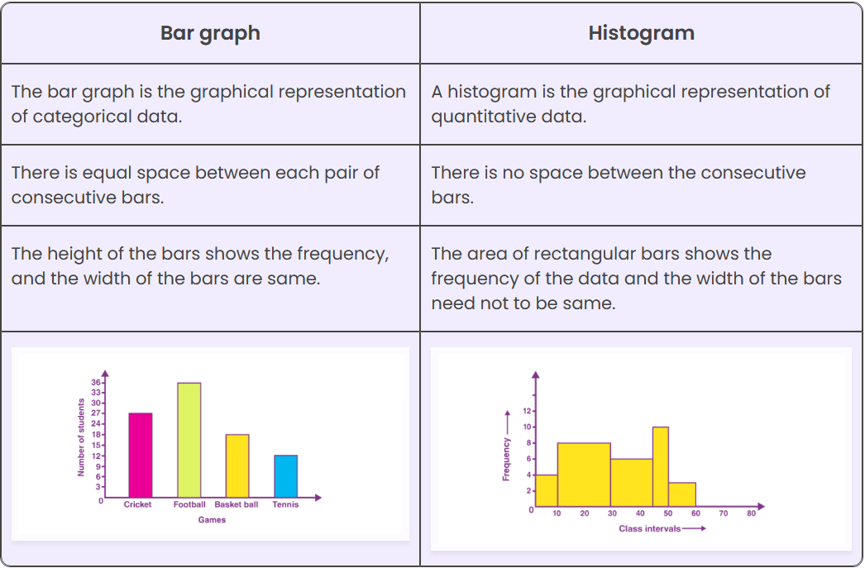

Slide 3
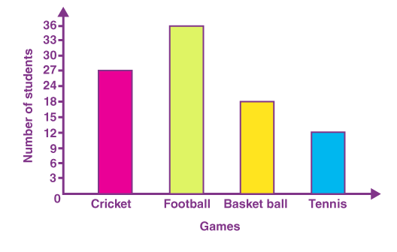
Bar Graph (Gaps between bars)

Slide 4
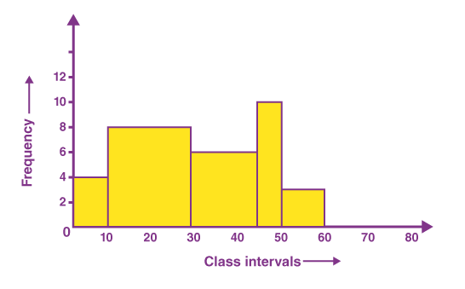
Histogram (No gaps between bars)

Slide 5
A guy who’s weighs himself every Saturday for the past 30 weeks. The table below shows his recorded weights
135 | 137 | 136 | 137 | 138 | 139
140 | 139 | 137 | 140 | 142 | 146
148 | 145 | 139 | 140 | 142 | 143
144 | 143 | 141 | 139 | 137 | 138
139 | 136 | 133 | 134 | 132 | 132
Interval | Frequency
131.5-133.5
135.5-137.5
137.5-139.5
139.5-141.5
141.5-143.5
143.5-145.5
145.5-147.5
147.5-149.5
For histograms, we usually want to have from 5 to 20 intervals. Since the data range is from 132 to 148, it is convenient to have a class of width 2 since that will give us 9 intervals.

Slide 6
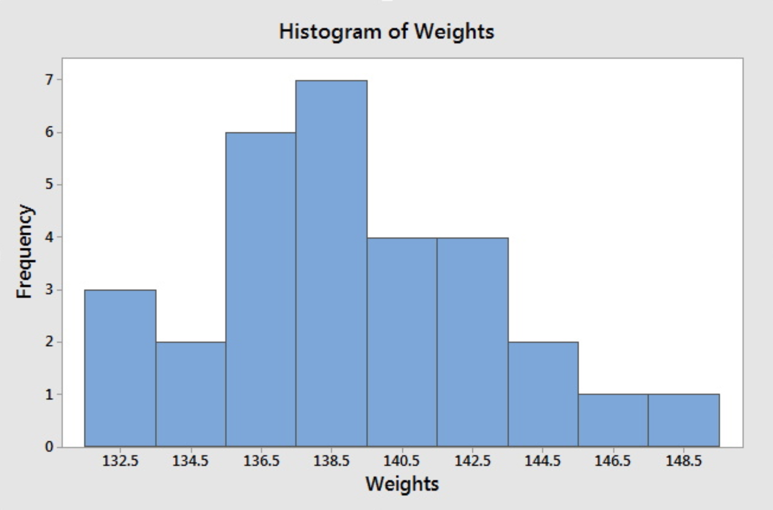

Slide 7
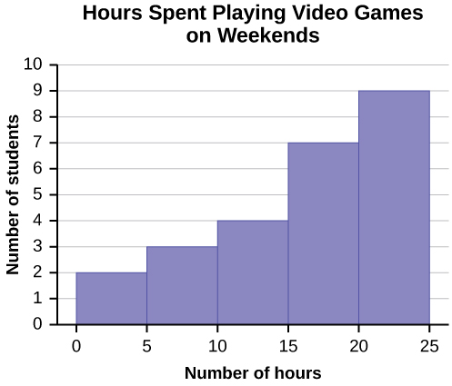
Number of Hours My Classmates Spent Playing Video Games on Weekends
9.95 | 10 | 2.25 | 16.75 | 0
19.5 | 22.5 | 7.57 | 15 | 12.75
5.5 | 11 | 10 | 20.75 | 17.5
23 | 21.9 | 24 | 23.75 | 18
20 | 15 | 22.9 | 18.8 | 20.5

Slide 8
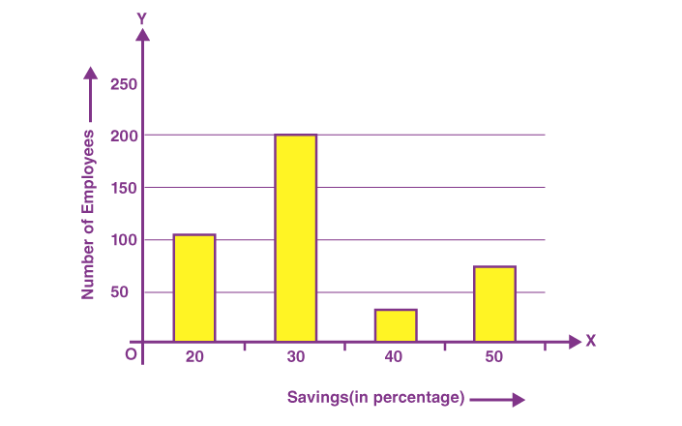
Savings (in percentage) | Number of Employees(Frequency)
20 | 105
30 | 199
40 | 29
50 | 73
Total | 400

Slide 9
Name of the Sport | Total Number of Students
Cricket | 45
Football | 53
Basketball | 99
Volleyball | 44
Chess | 66
Table Tennis | 22
Badminton | 37
Class work

Slide 10
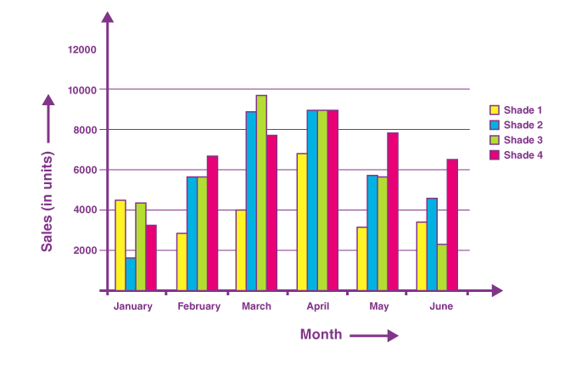
Month | Sales (in units)
 | Shade 1 | Shade 2 | Shade 3 | Shade 4
January | 4500 | 1600 | 4400 | 3245
February | 2870 | 5645 | 5675 | 6754
March | 3985 | 8900 | 9768 | 7786
April | 6855 | 8976 | 9008 | 8965
May | 3200 | 5678 | 5643 | 7865
June | 3456 | 4555 | 2233 | 6547

Slide 11
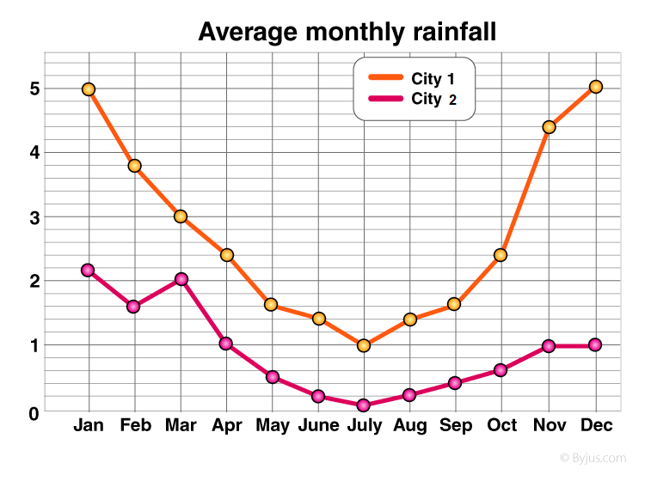
A line graph is a unique graph which is commonly used in statistics. It represents the change in a quantity with respect to another quantity

Slide 12
